Slide 1
EVIDENCIAS DE LA SEMANA
EDUCACIÓN FÍSICA
SEMANA DEL 17 AL 21 DE MAYO 2021

Slide 2
PLAN CLASE
.

Slide 3
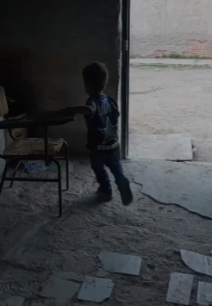

Slide 4
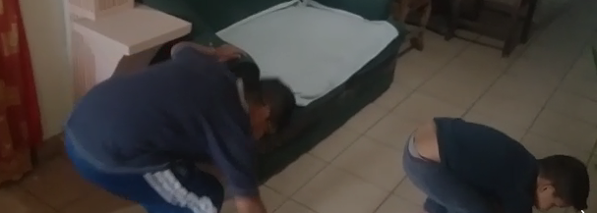

Slide 6
03
In Brief
You can describe the topic of the section here

Slide 8
Welcome!
You can describe the topic of the section here

Slide 9
whoa!
Catch your audience’s attention here

Slide 10
05
Events
You can describe the topic of the section here

Slide 11
It’s the rate of new cute couples
Foxes are cute and sleepy

